Slide 1

Medicine Management System
TY_A_Batch_1_Group_3
Adhiraj Jagdale (04)
Anusha Agrawal (11)
Harshita Agrawal (12)
Mahesh Ahire (14)
DBMS Minor Project:
Guide: Dr.Abhay Chopde

Slide 2
Contents
Introduction
Literature Review
Methodology
Result
Conclusion
References

Slide 3
Introduction
Medicine Management System is a python database-management system that manages all medicine necessary details.
The main purpose of this system is to manage the medicine operation that includes medicine name, type of medicine, reference number, company name, lot number, issue date, expiry date, uses, side effects, precautions and warning, dosage, tablet price, and product quantity.
The proposed software helped to reduce the errors and paperwork.

Slide 4
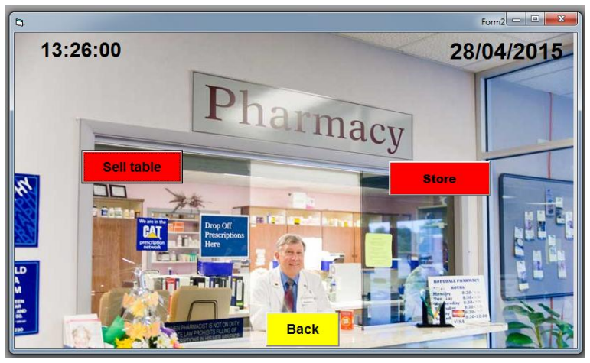
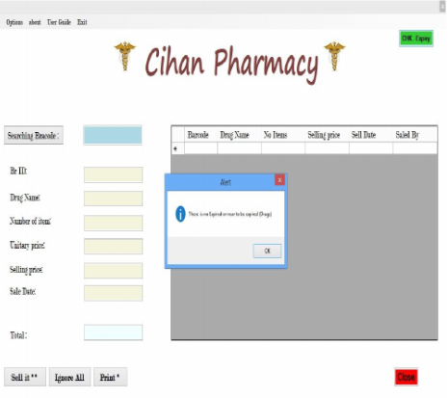
Literature Review
[1] Design an Information Management System for a Pharmacy
[2] Designing a Computerized Pharmacy Management System with Inventory Stock Alert System
2018
2018

Slide 5
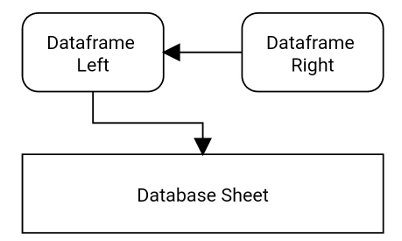
Methodology
Software Requirement:
Visual Studio Code
MySQL Workbench
Language Requirement:
Python
MySQL
1. DATAFRAMES:
In this system it consists of 3 main data frames that are:
Data frame Right
Data frame Left
Database sheet frame
Fig.1. Block Diagram of Data frames

Slide 6
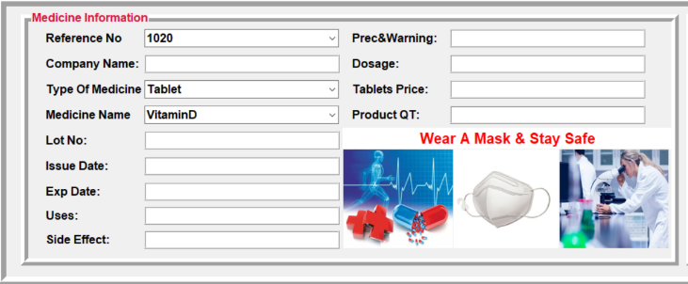
Methodology
2. Main Modules of the System:
2.1. Medicine Information Frame Module:
This module is used to fill detail about medicine details about reference number, company name, lot number, issue date, expiry date, uses, side effect, precautions and warning, dosage, tablet price, and product quantity.
In system reference number, type of medicine, medicine name these are combo boxes, in which we just have to select one option out of multiple.
Fig.2. Medicine Information Frame Module

Slide 7
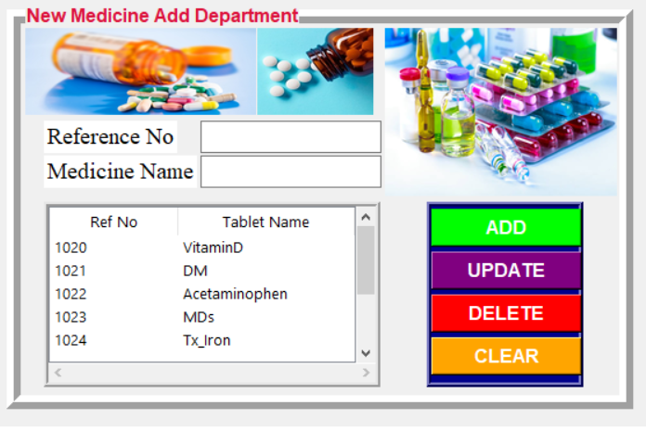
Methodology
2.2. New Medicine add department Frame Module:
This module includes a reference number, medicine name, and four buttons namely add, update, delete, and clear.
Where we have to fill in new references number and medicine names, then just clicking on add button will directly add those new reference numbers and medicine names to the medicine information frame module’s combo box respectively.
There is also one table included in this frame to see all reference numbers and medicine names available in the system, and we can update, delete them by selecting reference number and medicine name then click on update or delete, the system will act respectively.
Fig.3. New Medicine add department Frame Module

Slide 8
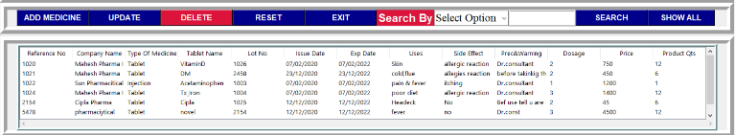
Methodology
2.3. Database Frame Module:
It stores all information about medicine and will be represented in the sheet which is presented in this module.
It also includes buttons as follow:
Add Medicine
Update
Delete
Reset
Search
Show All
Exit
Fig.4. Database frame module

Slide 9
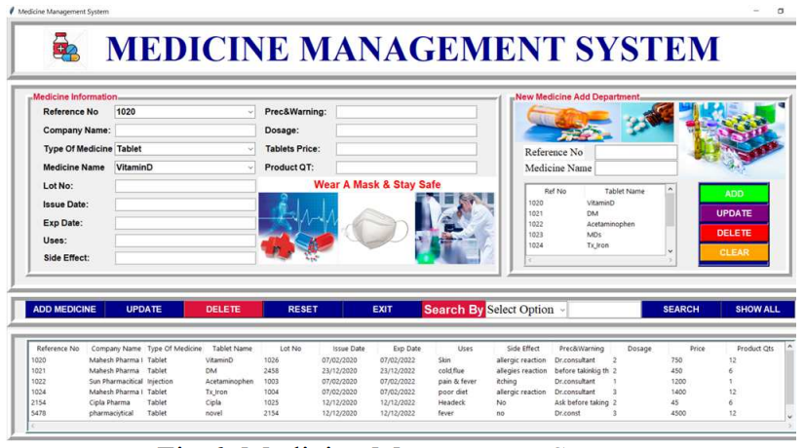
Result
This system contains only a single Medicine management system frame.
In short medicine, the manager will be able to fulfill his/her requirement related to medicine.
The system easy to understand, reduces chances of human error, is less time consuming, and will give accurate results.

Slide 10
Conclusion
This system provides us with a user-friendly interface to manage the medicine details.
This work will be able to help in the pharmaceutical area where pharmacy/medicine shop managers can make use of this system to store medicine-based information.
In future, with this system we can merge medicine related transaction system for pharmacy/medicine shop.

Slide 11
References
[1] Zangana, Hewa Majeed. “Design an Information Management System for a Pharmacy.” IJARCCE (2018) doi:10.17148/IJARCCE.2018.71012
[2] Baker, Asan. (2018). Designing a Computerized Pharmacy Management System with Inventory Stock Alert System. International Journal of Emerging Trends & Technology in Computer Science. 5. 68-71.
[3] Y. Shuxun, W. Ying, L. Huan and L. Yun, "Application to Medicine Management Based on Computer Network Aided System," 2013 Fourth International Conference on Intelligent Systems Design and Engineering Applications, 2013, pp. 161-165.
[4] Dridi, Ahmed & Tissaoui, Anis & Sassi, Salma. (2015). The medical project management (MPM) system. 10.1109/GSCIT.2015.7353336a

Slide 12
Thank You!

